Slide 1


OPS Lecture 4:
Serial Communication
Notes:
Jackie

Slide 2

Find a partner!
Find someone to partner up with:
project 4 requires 2 arduinos!
Notes:
Bryan

Slide 3
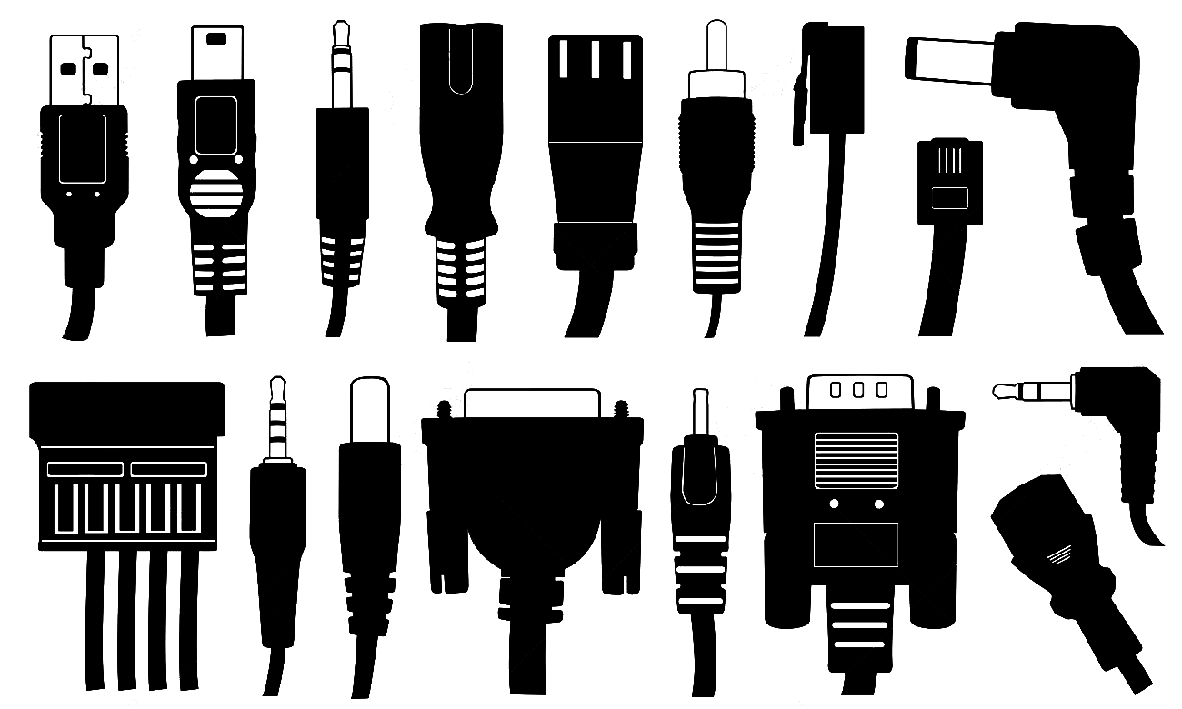
Communication Protocols
Defined as sending signals from one source to another
Needed for systems of many electronics
Various different standardized communication protocols for different purposes
Notes:
Jackie

Slide 4


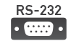

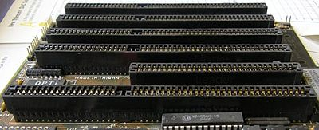



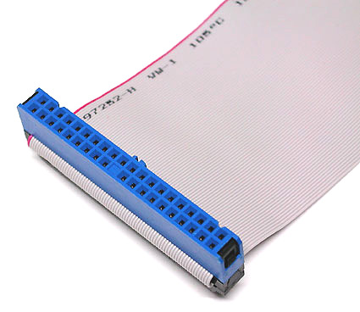
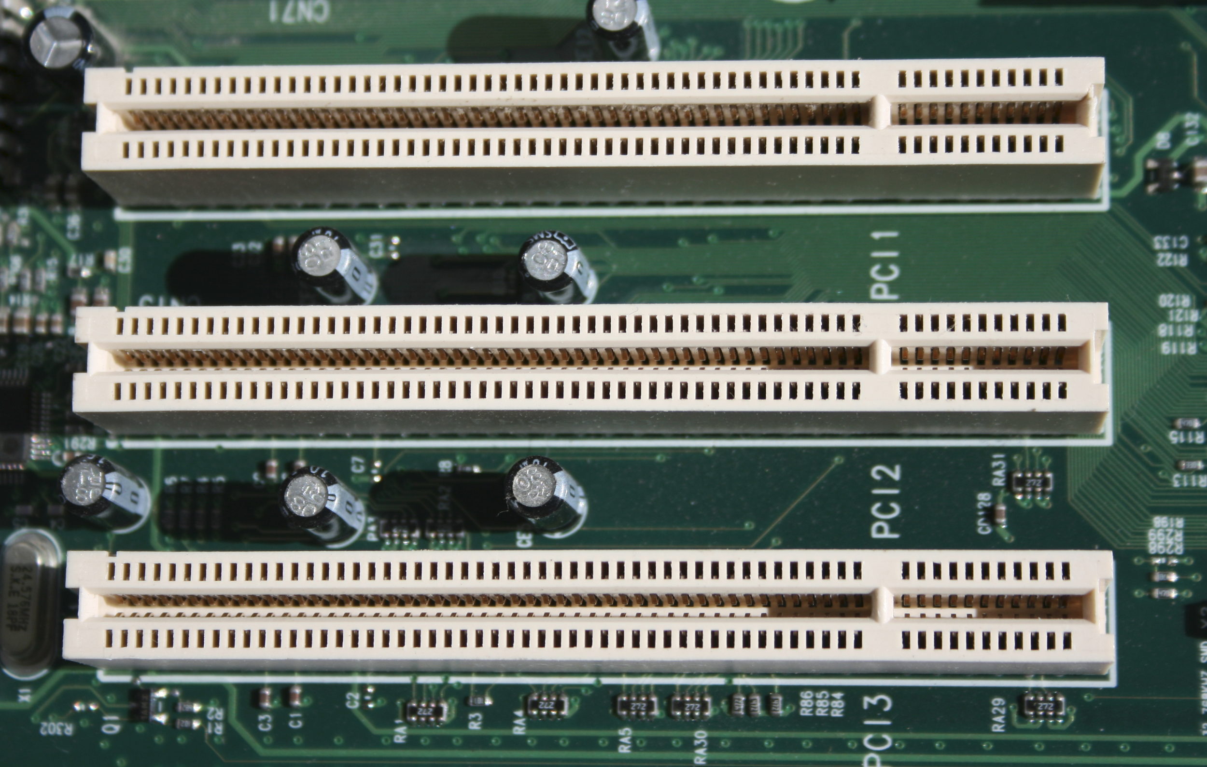



Two Types of Protocols:
Serial
Parallel
SCSI
ISA
Parallel ATA
Conventional PCI

Slide 5
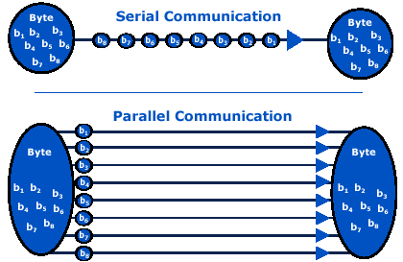
Serial vs. Parallel
Serial: sending data in packets one at a time
Parallel: higher bandwidth, but…
Cable complexity
Hardware implementation
Inter-wire crosstalk
Larger physical size
*Bandwidth is just max data rate over a network. E.g. 1000Mbps

Slide 6
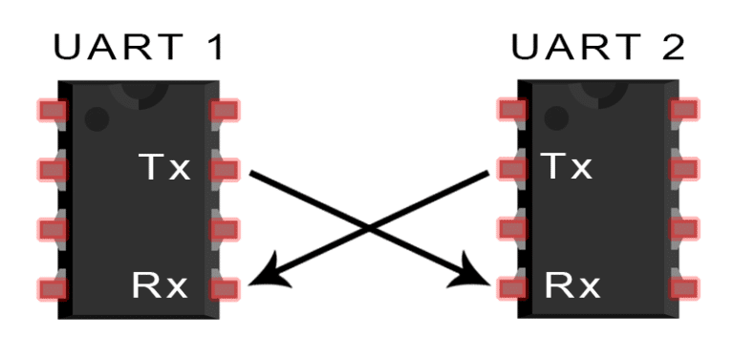
Universal Asynchronous Receiver/Transmitter (UART)
Arduino’s version of Serial communication
Not a communication protocol, but a physical circuit
Asynchronous because, unlike communication protocols, UART does not use a clock signal
Adds start and stop bits to packet
Allows Arduino to communicate with other devices
Library functions here

Slide 7
How data is sent between 2 UARTs
UARTs designed to transfer between only one device to another
Data sent in packets
Start and stop bits since UART is asynchronous
Data Packet
1 start bit | 5-9 data bits | 0-1 parity bits | 1-2 stop bits
Data Frame

Slide 8
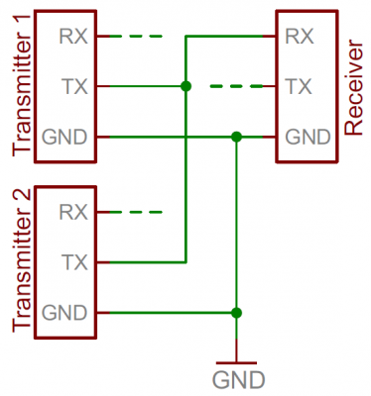
What is wrong with this?
??????
Same bus line
011001
2 UARTs trying to put data on the same bus
This is bad!
Both won’t actually be able to transmit their data
It’s like when 2 people are trying to talk to you at once :(
011001101
011011

Slide 9
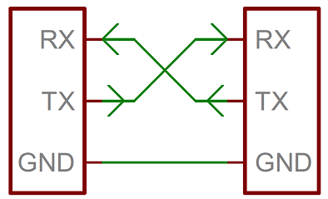
Connecting Two UARTs
Transmitter (TX) and Receiver (RX) are connected as pictured
Pins 0 and 1 on your Arduinos
Devices share a connected common GND
Both devices must be set to the same baud rate! (rate at which data is transferred)
Serial.begin(9600) means send/reading at 9600 bits/second

Slide 10
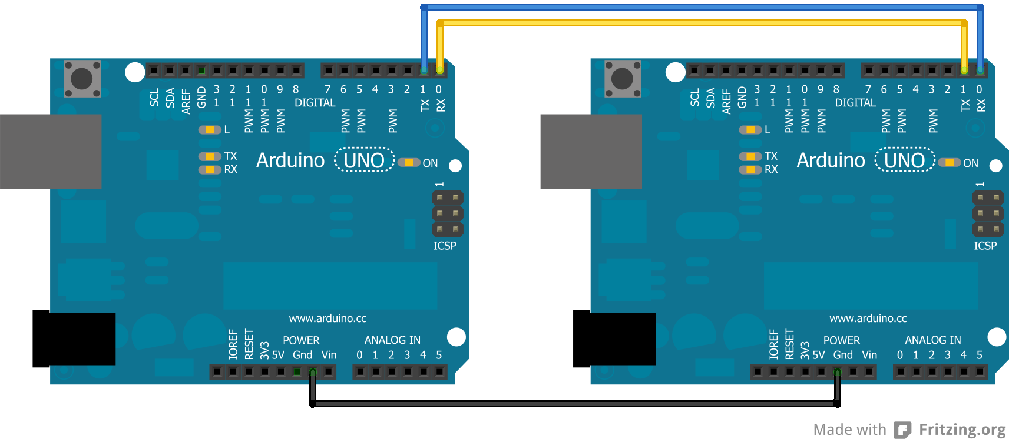
Connecting Two UARTs on Arduino to Transfer Data
Notes:
Ask why Tx needs to be connected to Rx on the other device

Slide 11
Arduino functions to TRANSMIT
Parameters
val: a value to send as a single byte
str: a string to send as a series of bytes
Returns
Write() will return the number of bytes written to transmit buffer
1 character = 1 byte
“hello” = 5 bytes
Functions
Serial.write(val)
Serial.write(str)
Serial.write(buf, len)
Link to Arduino doc: https://www.arduino.cc/reference/en/language/functions/communication/serial/write/

Slide 12
Arduino functions to RECEIVE
Parameters
No parameters
Returns
The first byte of incoming serial data available (or -1 if no data is available)
Data type: int
1 character = 1 byte
“hello” = 5 bytes
Functions
Serial.read()
Link to Arduino doc: https://www.arduino.cc/reference/en/language/functions/communication/serial/read/

Slide 13
Sample Code
void loop() { /* Check if data has been sent to the computer. Returns # of bytes in the receive buffer */ if (Serial.available()>0) { /* read the first byte from the
receive buffer */ byteRead = Serial.read(); /* ECHO the value that was
read, back to the serial port. */ Serial.write(byteRead); } }
/* initialize global variable to store the read byte */
char byteRead; void setup() { /* Turn the Serial Protocol ON and set the baud rate*/ Serial.begin(9600); }

Slide 14
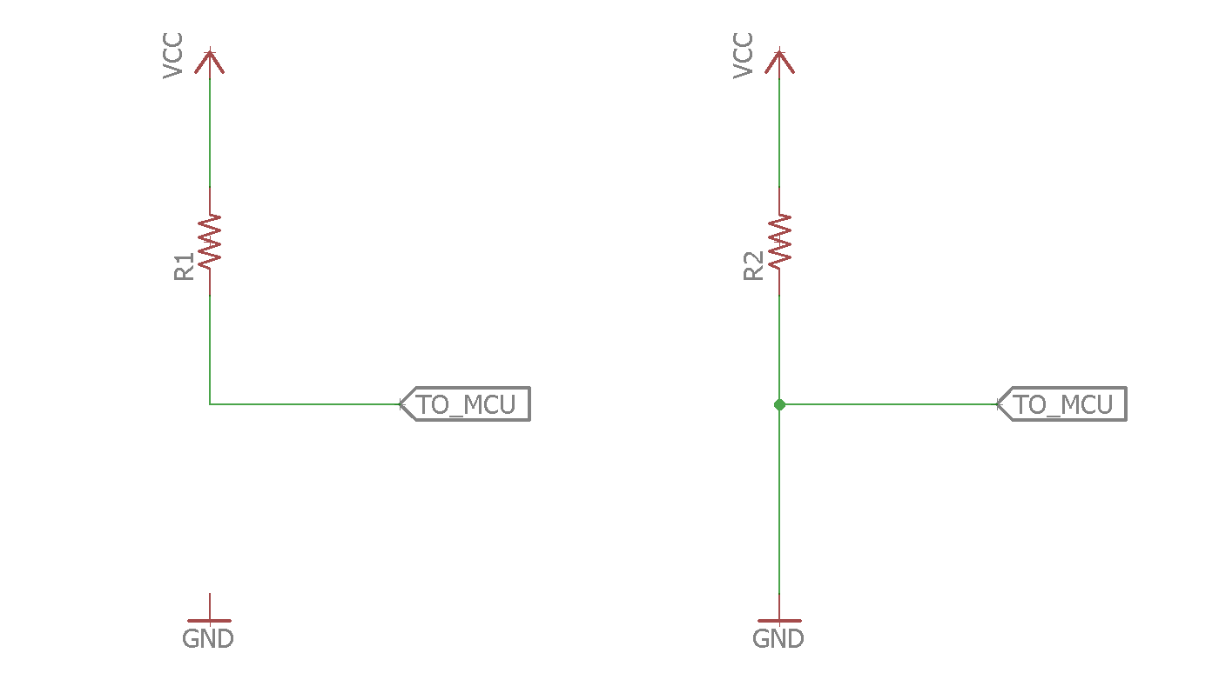
Quick Aside: Reading Voltages at a Pin
3.3V
3.3V
What voltages are read by the MCU here?
VCC (3.3V)
GND (0V)
1.
2.
Notes:
Jackie

Slide 15
Quick Aside
3.3V
What voltages are read by the MCU here?
Input pin has very large resistance compared to R1
VCC (3.3V)
Voltage divider
More voltage across larger resistance
Most of voltage drop is across input pin and very little across R1
1.

Slide 16
Quick Aside
Input pin has very large resistance compared to R2
3.3V
Current
What voltages are read by the MCU here?
GND (0V)
Pin is connected to ground directly
Alternately, current flows through path of least resistance, so all of voltage drop is across R2
3.3V - VR2 = Vpin
3.3V - 3.3V = 0V = Vpin
2.
0V

Slide 17
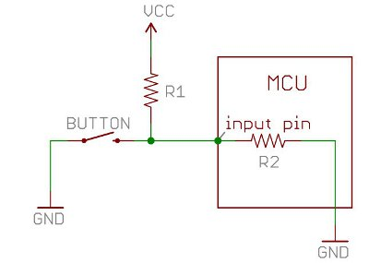
Why do the input pins need to have such a high resistance?
Less current will be drawn to consider voltage as HIGH or LOW
Makes it useful for reading a sensor value
Will drain power if resistance is very low
Notes:
Imagine the input impedance was ridiculously low, say 1Ω. You'd have to somehow supply 5A to bring the input up to 5V.
If the input impedance was more sensible, say 10kΩ, you'd need to supply 500µA only to read the same 5V value
Thus by decreasing the input impedance, we increased the amount of current needed to cause a state change (in this case 12nA to 12uA)

Slide 18
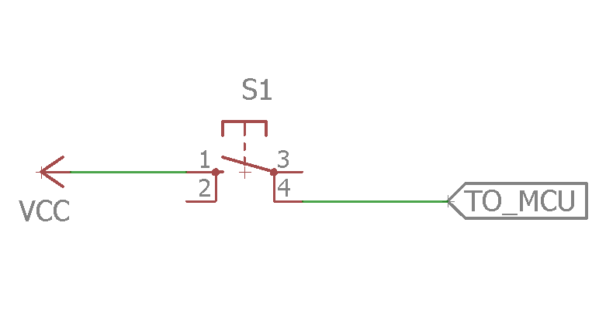
Using Buttons with Arduino
Using analogRead( ) on a pin returns the voltage at that pin, relative to GND
So if the button is not pressed, what’s read here?
Open switch

Slide 19
Using Buttons with Arduino
Using analogRead( ) on a pin returns the voltage at that pin, relative to GND
So if the button is not pressed, what’s read here?
Random values!
This could break something.
Solution: connect it to something!
Open switch

Slide 20
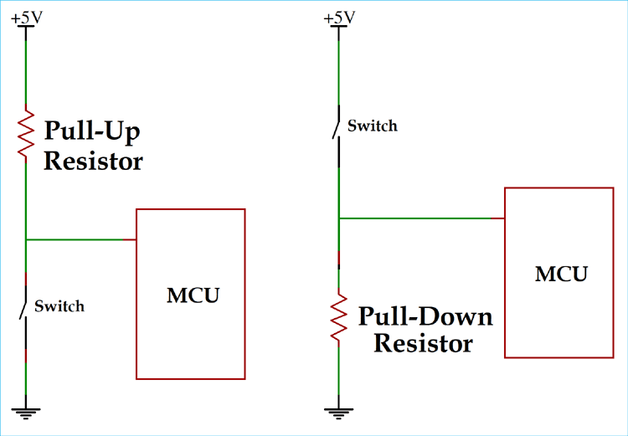
Pull-Down Resistors
Switch is OPEN
By adding a pull-down resistor, the default state of the pin will now be GND!
When the button is not pressed, the pin will read LOW
R1 << Rpin so voltage drop across R1 is negligible
R1

Slide 21
Pull-Down Resistors
Switch is CLOSED
When the switch is closed, current flows from
VCC → R1 → GND
Since R1 << Rpin
Pin will read HIGH
VCC is directly connected to the pin
Current
R1

Slide 22
Pull-Up Resistors
Similarly, a pull-up resistor makes the default state of a pin HIGH and when pressed, pin state will be LOW
Use one of these when working with buttons and MCUs!

Slide 23
Choosing a Pull-Up/ Pull-Down Resistor value
Rule of thumb
1/10 of input resistance
If you want to calculate the exact resistor value, refer to this:
https://docs.google.com/document/d/1VhyNxWdOgFwMU53riI1OzfsRg7GCDxjPxRm-IMI6WfM/edit?usp=sharing

Slide 24
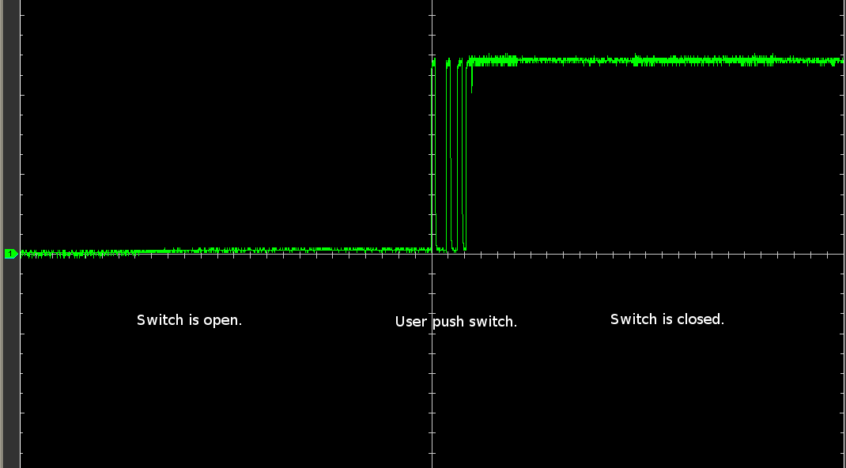
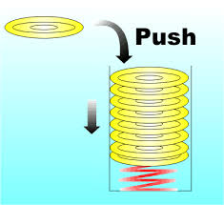
Button Debouncing
When you press a button, it bounces slightly due to its internal springs, creating an unstable signal
Voltage rapidly bounces between HIGH and LOW
Notes:
Bryan

Slide 25
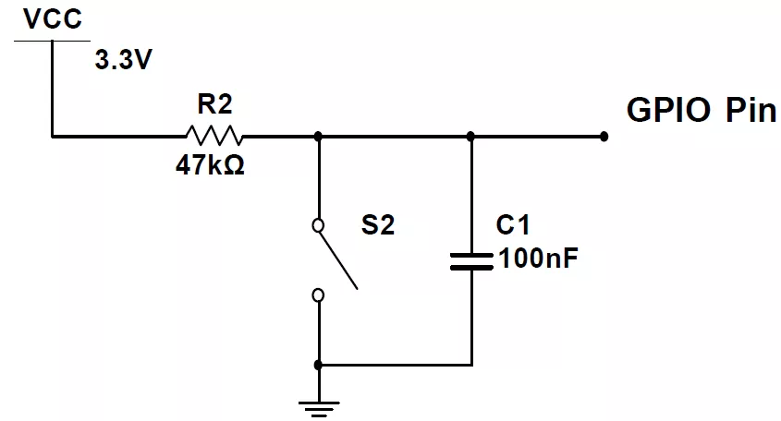
Button Debouncing
In order to correct for this, we can add a debouncing element
We can add a capacitor!
Capacitors take time to charge/discharge, so it prevents rapid voltage changes from the bouncing switch
Voltage across capacitor is hard to change immediately unless in parallel
Input Pin

Slide 26
Button Debouncing - Step by Step
Due to the pull-up resistor, the default state of the pin is 3.3V
When the button is open for a long time, the capacitor is fully charged and acts like it’s not there.
Input Pin
3.3V

Slide 27
Button Debouncing - Step by Step
Due to the pull-up resistor, the default state of the pin is 3.3V
When the button is open for a long time, the capacitor is fully charged and acts like it’s not there (open).
Input Pin
3.3V

Slide 28
Button Debouncing - Step by Step
When the button is pressed, the pin will immediately read GND
Capacitor and wire(0V) in parallel so voltages are the same! Or just shorting capacitor
Input Pin
0V

Slide 29
Button Debouncing - Step by Step
When the button is pressed, the pin will immediately read GND
When the button is released, the capacitor will gradually fill with charge until it matches 3.3V. The pin will also read this increasing voltage.
Input Pin
0-3.3V
(gradual increase)
*If the switch starts bouncing, the capacitor will only discharge a small amount. Thus, the input pin won’t switch between LOW and HIGH

Slide 30
Button Debouncing - Step by Step
When the button is pressed, the pin will immediately read GND
When the button is released, the capacitor will gradually fill with charge until it matches 3.3V. The pin will also read this increasing voltage.
When the cap is fully charged, it once again acts like it’s not there.
Input Pin
3.3V

Slide 31
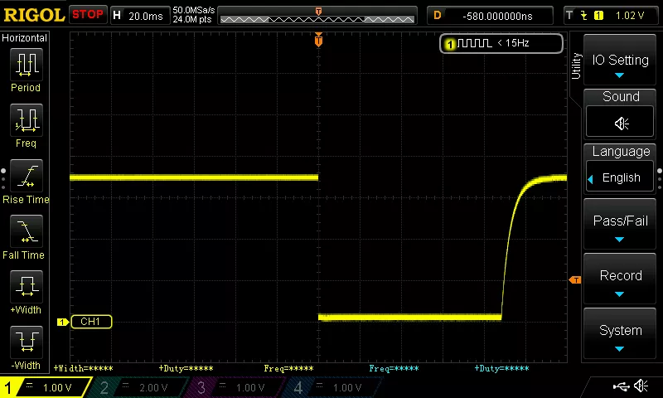
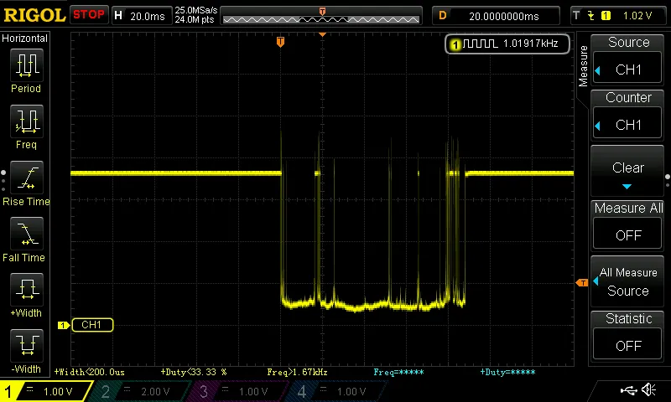
Button Debouncing
VS
Not Debounced
Debounced
Button debouncing can utilize either pull-down or pull-up resistors!

Slide 32


Slide 33

Aight, so it’s debounced!...
Right?
That’s everything IEEE UCLA has for push button debouncing...
What’s wrong with this?
Debounced

Slide 34
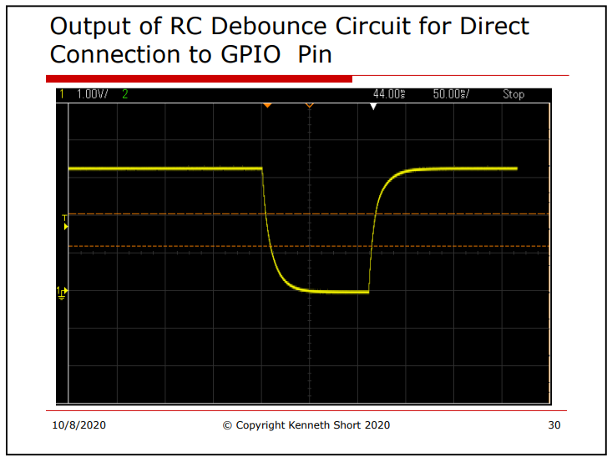
It’s only half debounced :[
Ideal oscilloscope screenshot
We need to debounce the press of the button as well...
Not good
From ESE 280: hardware debouncing, lab 6 (Prof. Short)

Slide 35
So what do we have to do?
We need to slow down the discharge when the button is pressed, so that the capacitor is still discharging while the button bounces around.
Input Pin
3.3V

Slide 36
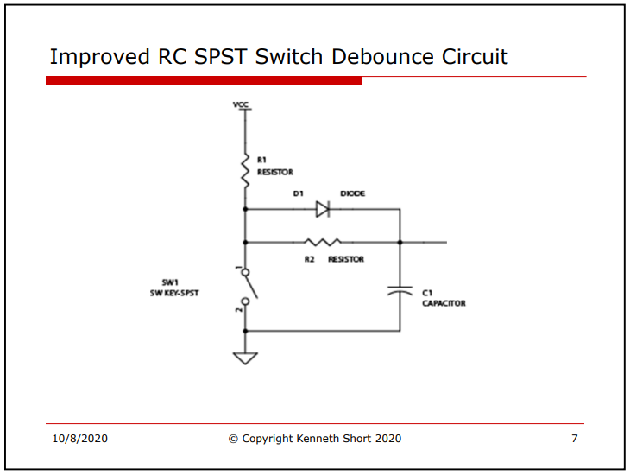
We need another resistor.
“Slowing down” discharge is done using another resistor between button node and capacitor/input pin node.
From ESE 280: hardware debouncing, lab 6 (Prof. Short)
So here

Slide 37
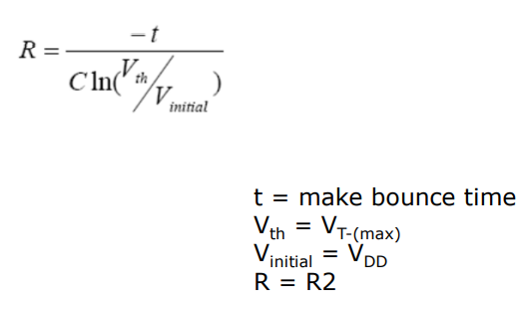

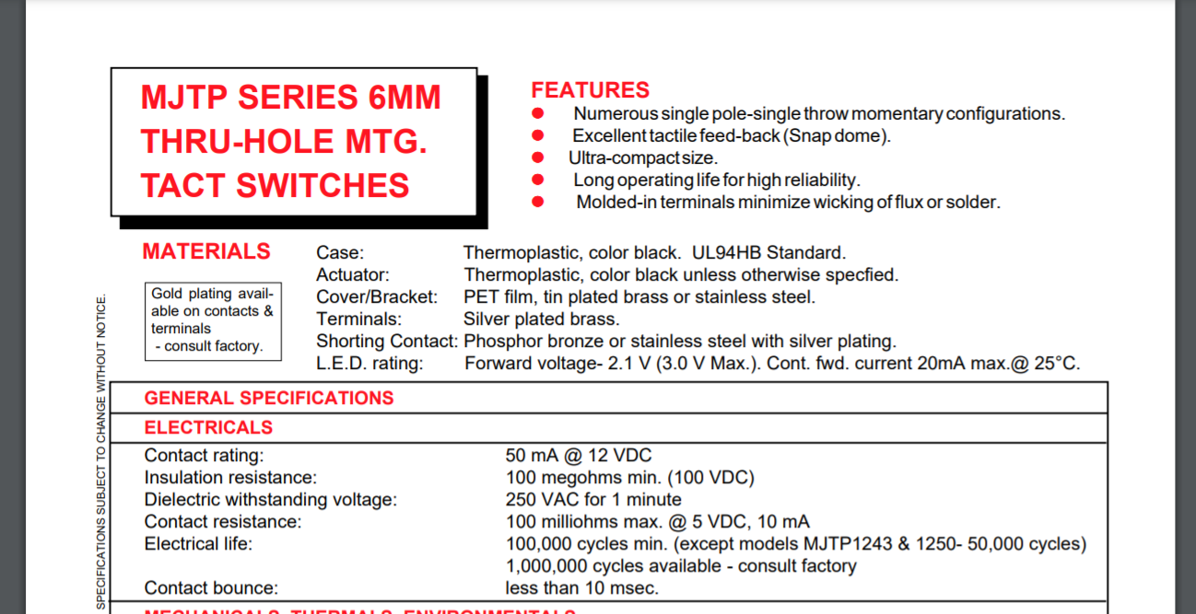
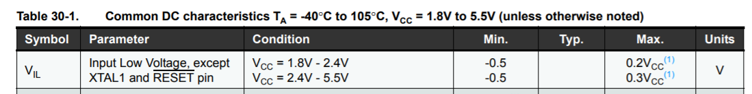
Calculating the resistor we need...
3. Steal Prof. Short’s equation (discharge equation for RC circuits) to find the resistor value...
1. Check the bounce time on the button from datasheet...
2. Get VT- max from ATmega328P datasheet
4. Plug in numbers: -10ms/[(100nF)ln([0.3*5V]/5V)] =
83958.354Ohms

Slide 38
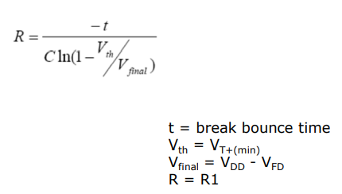

Let’s check the charge resistor (R1) as well...
If we keep the same capacitor, the first resistor should be around:
-10ms/[(100nF)ln(1 - [0.6*5V]/[5V-0.7V])] =
Our problems:
We’re missing a resistor.
Our first resistor doesn’t suffice for debouncing either.
(To top it off we’re also missing a diode to separate the two resistors: we’ll assume a zener diode with around 0.7V forward voltage)
In other words, we don’t have the right parts to fully debounce.
83594.513Ohms
You’ve all been warned… Our hardware debounce kinda jank.

Slide 39

Software Button Debouncing
We can also use code!
Ex: Take multiple samples, only recognize a button press as valid if a certain number of consecutive samples return the same value
...Or just delay :]
Notes:
Bryan

Slide 40

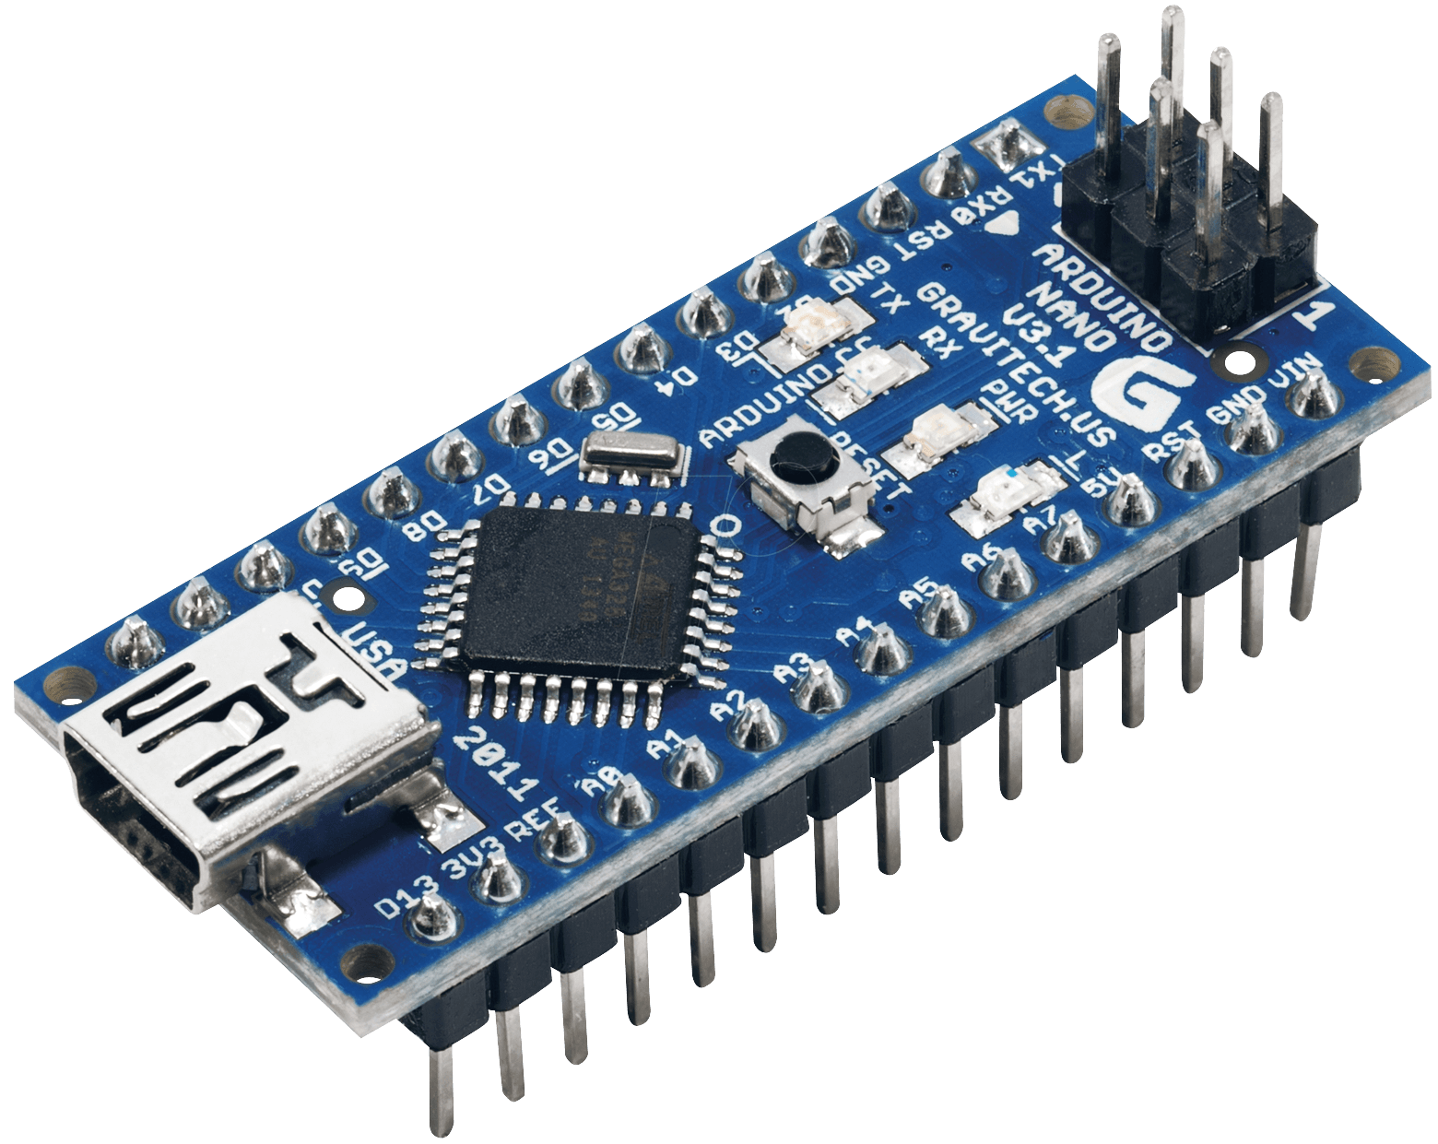
Project 4:
UART Red Light Green Light
Project Spec Here
Good luck ᕦ(ò_óˇ)ᕤ

Slide 41
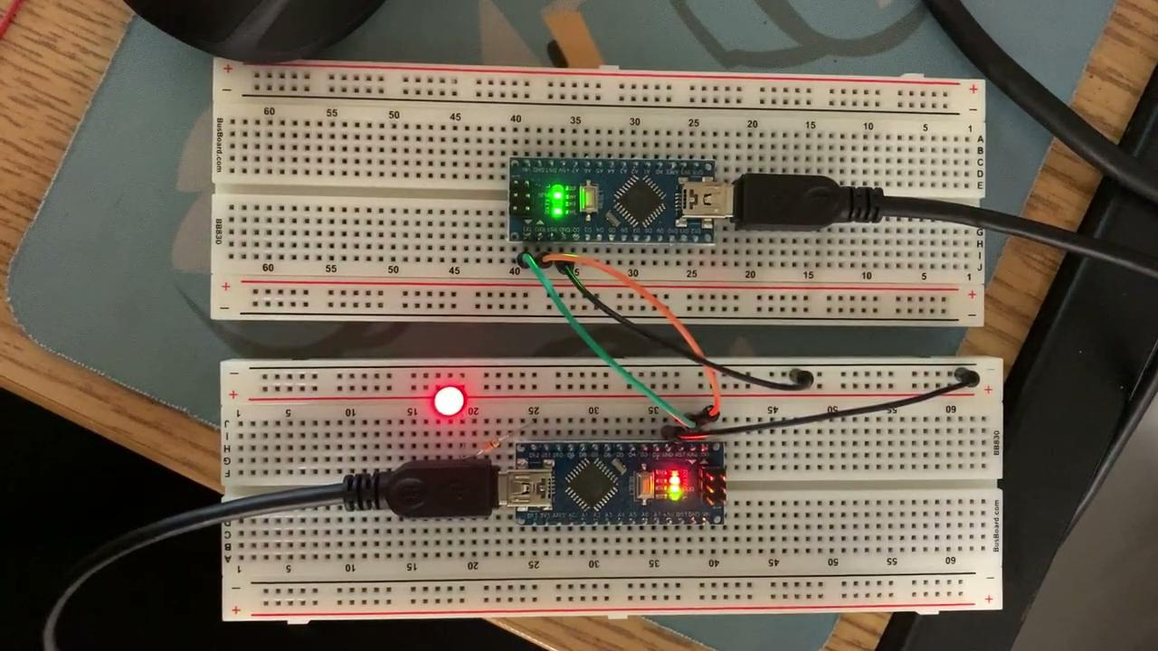
Mini project on Google Drive
“checkpoint 1” on the project 7 guidelines doc is on drive under “lecture 4 files” for your reference.
Check it out if you don’t know where to start for project 4!

Slide 42


Project Deadlines
Red light green light will be due:
Monday Students: 11/8
Thursday Students: 11/11
More project details here
Come to our LAB HOURS for help!
Check out lab hours for:
(Mon): Ryuichi, Rachel, or
(Thur): Wesley, Paula

Slide 43
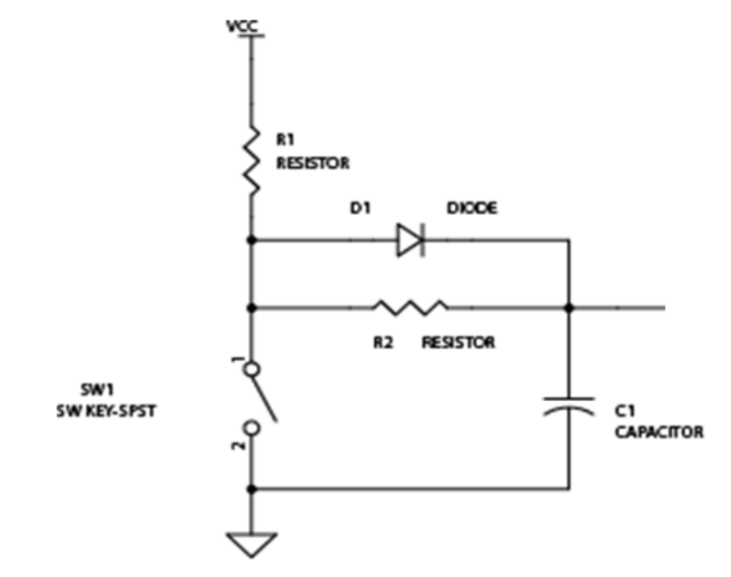
…(If we wanted to fix the circuit):
If we change the capacitor to 1uF...
Then R1 = 8359 Ohms and R2 = 8305 Ohms
If we round up we can get this to work with two 10k Ohm resistors and a diode.

Slide 44

Thank You!

